Slide 1

Lending Club Case Study
Ashok Vashist &
Bineesh Panangat

Slide 2
Agenda
Business Objective
Technical Solution
Approach
Analysis
Conclusion

Slide 3
Business Objectives
Understand the Driving factors behind Loan Defaults
Identify Risky Loan Applicants
Reduce the Credit Loss
Exhaustive Data Driven Analysis for Decision Making

Slide 4
Technical Solution
We would be leveraging Exploratory Data Analysis (EDA) technique often used by Data Scientist to analyze and investigate datasets and summarize their main characteristics using Data Visualization Methods. Few techniques used are as follows
Data Cleaning –
imputation, managing missing statistics, and removing outliers
Descriptive statistics Measures like suggest, median, mode, preferred deviation, range, and percentiles are usually used
Data Visualization histograms, box plots, scatter plots, line plots, heatmaps, and bar charts
Feature Engineering Normalization, binning, encoding, etc
Correlation and Relationships -
Data Segmentation -Dividing the information into significant segments based totally on sure standards or traits

Slide 5

Approach
Data Quality Steps
Data Cleanup
Dropping Rows
Find Duplicate Rows and Drop them
Remove header, footer or summary rows if any
Drop rows with No Column Values
Rows with high percentage of missing values (e.g. > 70%)
Dropping Columns
Drop columns that do not contribute to analysis such
Long text
Columns where more than 70% of data is empty
Redundant columns such as Id and URL
Removing Nulls
With Multiple Zero Values
With NA Values

Slide 6
Approach
Data Manipulation
Convert Object Columns (such as dti, loan_amnt ) into float
Strip % from int_rate column and convert into float
For Analysis based on “month” strip month from term column
emp_length to be converted into integer and round off eg 10+ to 10, <1 could be 0
loan_status to be converted into boolean value
Introduce Additional columns
Extract Month and Year from issue_d column
Loan Status can be converted into Boolean and stored in another column
Verification status can be stored into another column where in
Verified = 1 , Source Verified = 2 and Not verified =3

Slide 7
Analysis on critical columns
Employment Length(emp_length) – Higher the tenure more the financial stability and greater chances of loan payment
Annual Income (annual_inc) - Annual income of the customer,higher the income, more chances of loan pass
State (addr_state) - There could be higher delinquency or defaulters demographical
Debt to Income (dti) - The percentage of the salary which goes towards paying loan. Lower DTI, higher the chances of a loan pass
Home Ownership (home_ownership) - Owning a home adds a collateral which increases the chances of loan payment

Slide 8

Visualization

Slide 9
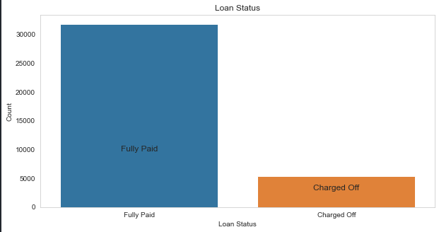
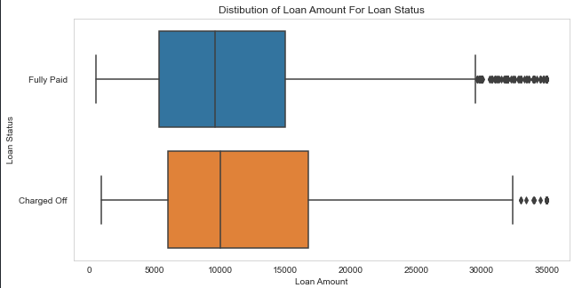
Loan Status and Amount
Loan Status: The number of charged off loan is much smaller(14.5%) compared to total count.
Loan Amount: It varies from 500 to 35000 with a median of 10000. Loan amount is majorly small and very few clients have taken large loans and larger it goes we have higher chance of defaulting.

Slide 10
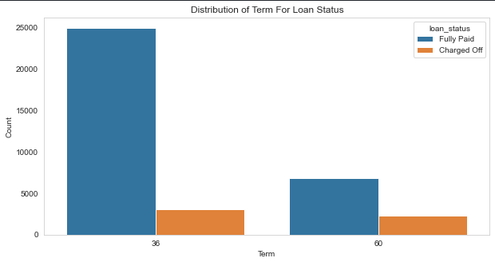
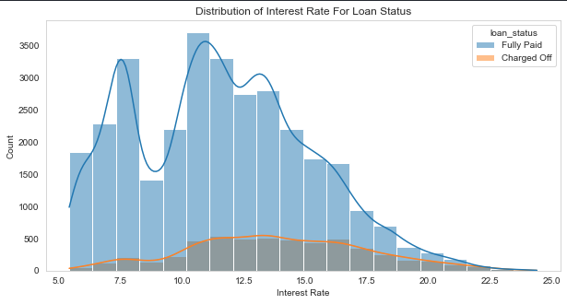
Term and Interest Rate
Loan Term: The Loans taken for 36 month term are much more than 60 months and have lower chance of defaulting.
Interest Rate: The count of loan taken varies with interest rate showing peak around in 5-15 bracket and decreasing slowly where as the chance of defaulting increases with interest rate.

Slide 11
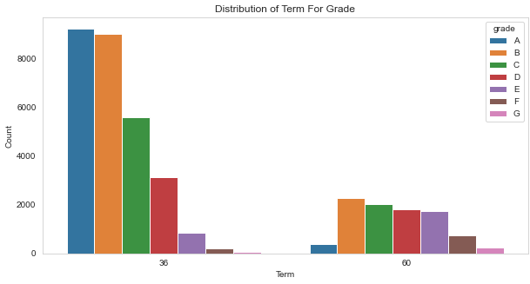
Distribution terms for Grades
Grade: The loan approved are majorly of higher grade as they are of low risk thus low chance of defaulting. 60 month term loans have larger number of lower grade loans with high risk.

Slide 12
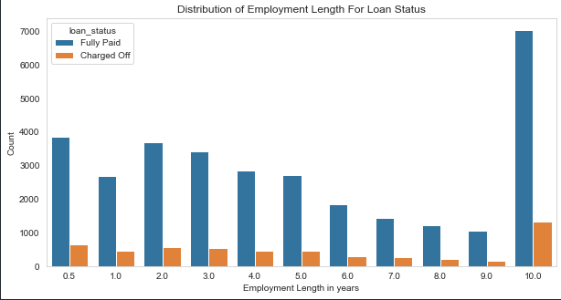
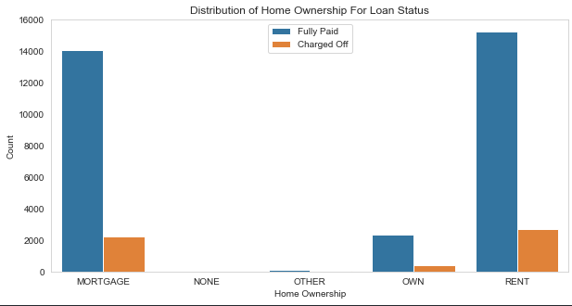
Employment Length & Homeownership
Employment Length: Majority of clients have 10+ years of experience and has highest number of defaulted loan.
Home Ownership: Majority of clients are lacking ownership of any property and are on rent or mortgage and have a higher chance of defaulting.

Slide 13
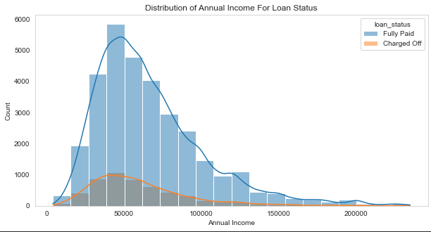
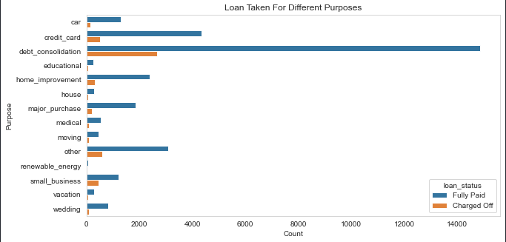
Annual Income & Purpose
Annual Income : The Majority of clients have low annual income compared to rest and income lower than 50k has higher chance of defaulting.
Purpose: Loans are taken mostly for debt consolidation followed by credit card payment. Whereas the debt consolidation has highest fully paid loan but also has highest defaulted loans as well.

Slide 14
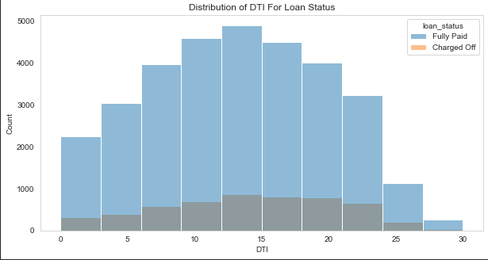
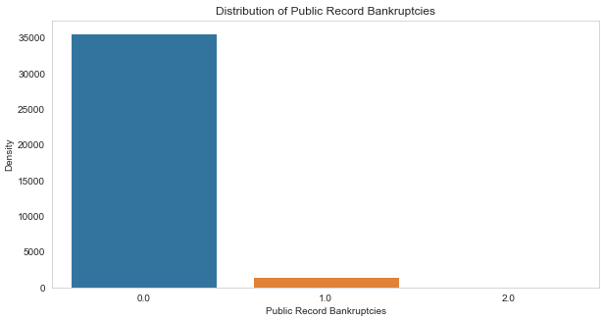
DTI ratio & Bankruptcy
DTI: The large percentage of Clients have a large Debt to Income ratio which shows that lending to such clients can be very risky.
Public Recorded Bankruptcy: Majority of clients have no record of declaring bankruptcy.

Slide 15
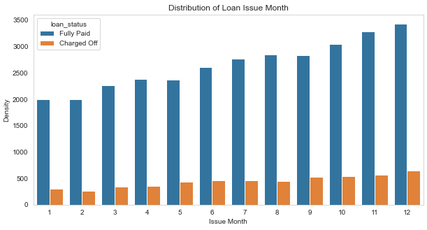
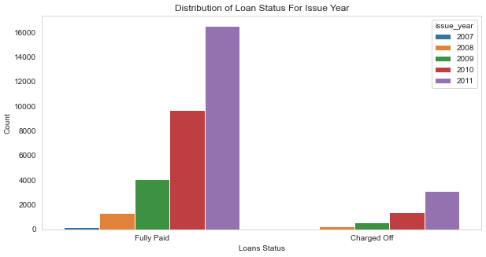
Loan Trend over years
We see a gradual increase in loan taken through the year, with lesser defaulting rate in April ,August, December quarter wise and better more late in year.
With each passing year loan taken are increasing exponentially which indicate we are seeing large increase in DTI ratio and decrease in defaulting rate.

Slide 16
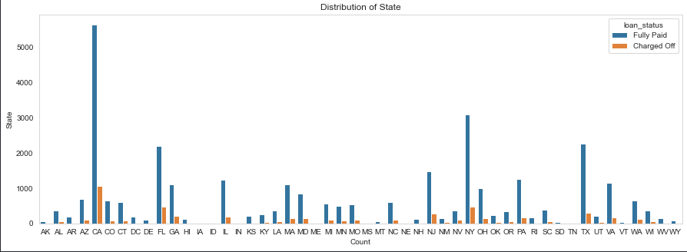
Location Based
For large metropolitan cities we see large number of loans, with higher number of defaulted loans like California, New York, Texas, Florida but have a lower chance of defaulting.

Slide 17
Add some HeatMaps & Scatter Plots - Bineesh

Slide 18
Feature Engineering - Bineesh

Slide 19
Coorelations & Relationships

Slide 20
Univariate , bivariate and Decision Matrix

Slide 21
Insights
Major Driving factor which can be used to predict the chance of defaulting and avoiding Credit Loss:
1. DTI
2. Grades
3. Verification Status
4. Annual income
5. Pub_rec_bankruptcies
Other considerations for 'defaults' :
1. Burrowers not from large urban cities e.g. NewYork , California etc
2. Burrowers having annual income in the range 50000-100000.
3. Burrowers having Public Recorded Bankruptcy.
4. Burrowers with least grades like E,F,G which indicates high risk.
5. Burrowers with very high Debt to Income value.
6. Burrowers with working experience 10+ years.

